Slide 1
HEAVY RAIN
TRAILER ANALYSIS
AND PROMOTIONAL SCHEDULE

Slide 2
Marketing and Promotion Campaign: Heavy Rain
Game Developer: Quantic Dream
Game Publisher: Sony Computer Entertainment
Platform: PS3 only
Genre: Interactive drama / action and adventure
Year of Release: 2010
Cost: £34 million to make including production, marketing and distribution
Sales: No. 1 game in UK on week of release – 95,000 copies sold 2 million copies sold in total. Sony earned more than £86 million
No. 9 in the Top 10 Games of 2010
Awards: BAFTA – best music, story and technical innovation

Slide 3
Marketing and Promotion Campaign : Heavy Rain
Date | Type of Promotion
04/01/2010 | Facebook page
15/01/2010 | Official website goes live
25/01/2010 | Twitter page
26/01/2010 | ‘Four Days’ online experience (over four weeks)
22/02/2010 | Premiere in Paris
23/02/2010 | TV advert released
23/02/2010 | Game released (PS3 only)
24/02/2010 | YouTube channel
26/02/2010 | Special Edition – extra downloadable content
24/03/2010 | Heavy Rain 'Four Characters' wallpaper
29/03/2010 | Soundtrack released
11/08/2010 | Move Edition screenshots
14/09/2010 | Move Edition pack shots
14/09/2010 | Move Edition demo – PlayStation Store
01/10/2010 | The Making of Heavy Rain Move Edition video
08/10/2010 | Move Edition released

Slide 4

1
Shot Description
PS3 logo and ident
Action
Logo appears with red swirl
Duration – 0.5 secs
Cut/Edit – fade into
Dialogue – None
Music – orchestral violins, dramatic
Noise/SFX – heavy rain and thunder

Slide 5
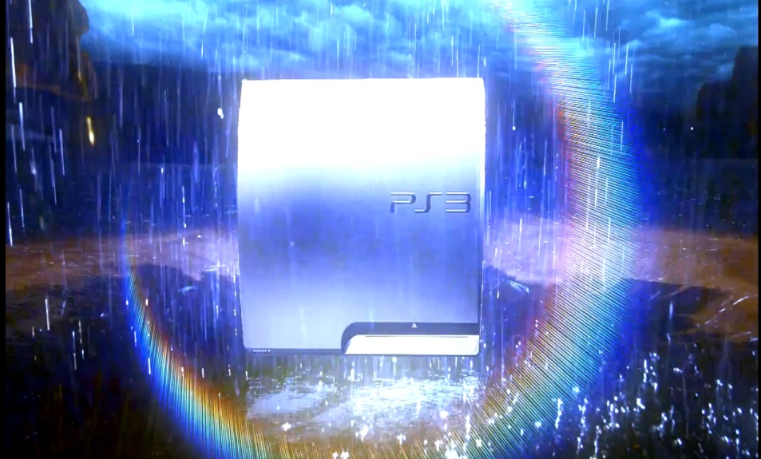
2
Shot description
Wide shot focusing on PS3 console
Action
Logo has faded into a PS3 console shown in the location setting
Duration – 0.5 secs
Cut/Edit – fade
Dialogue – none
Music – orchestral violins, dramatic
Noise/SFX – heavy rain and thunder

Slide 6
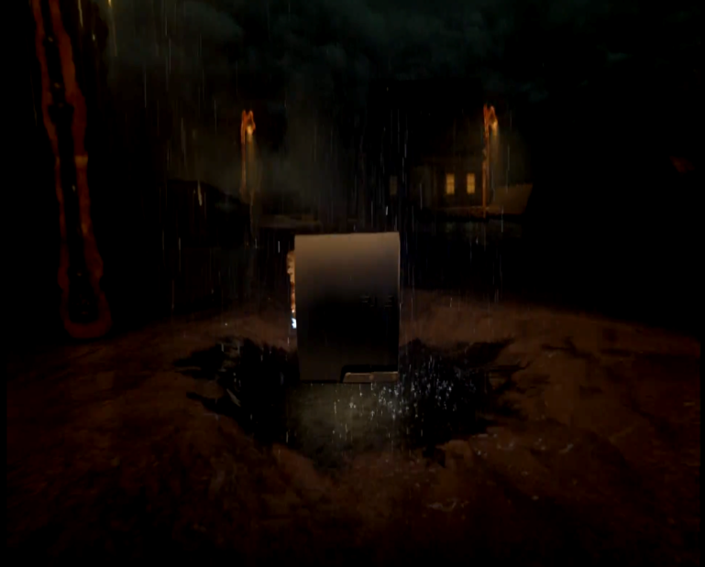
3
Shot description
ELS establishing shot
Action
Setting is shown
Duration – 1 sec
Cut/Edit – fade
Dialogue – voiceover narration 'Start'
Music – orchestral violins, dramatic
Noise/SFX – heavy rain and thunder

Slide 7
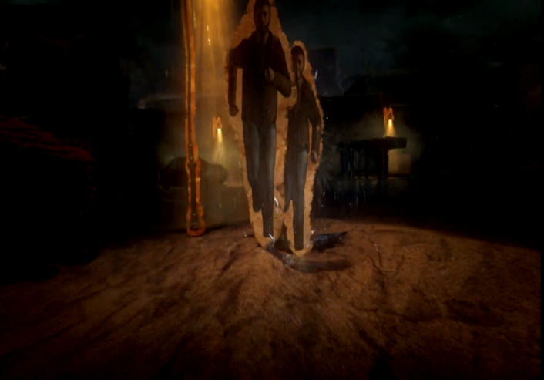
4
Shot description
Long shot – camera on dolly in reverse
Action
Features a figure of a man which repeats,
following him
Duration – 1 sec
Cut/Edit – fade
Dialogue – voiceover narration 'Start a journey which changes'
Music – orchestral violins, dramatic
Noise/SFX – heavy rain and thunder

Slide 8
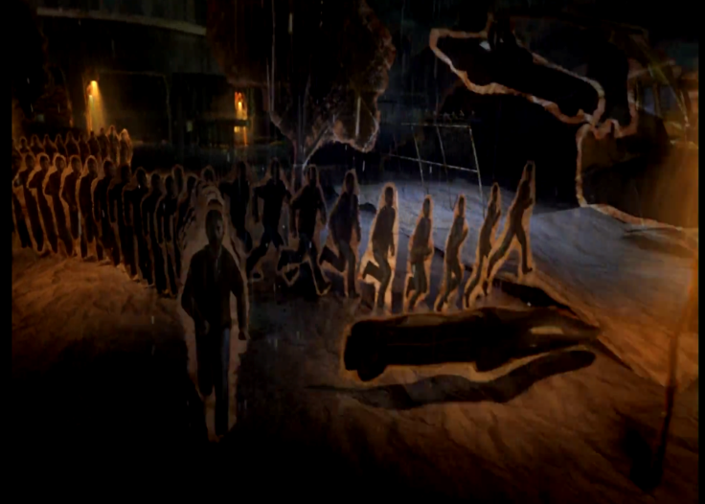
5
Shot description
Long shot – camera on dolly in reverse
Action
The figures of men split into different directions
Duration – 2 secs
Cut/Edit – fade
Dialogue – voiceover narration 'with every single decision.'
Music – orchestral violins, dramatic, getting louder, choral voices added
Noise/SFX – heavy rain and thunder

Slide 9
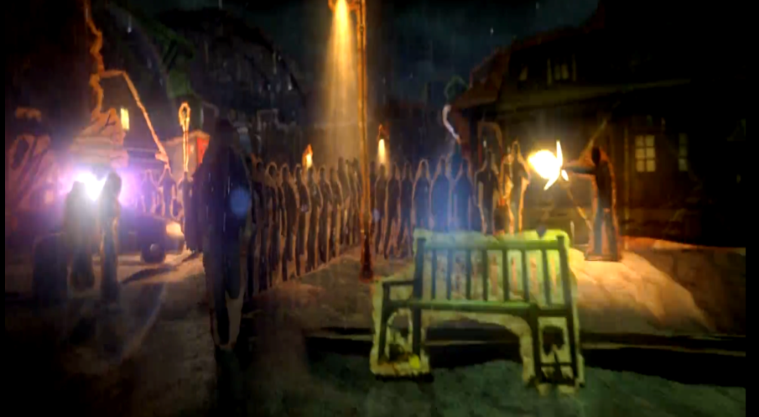
6
Shot description
Long shot – camera on dolly in reverse
Action
The figures of men split into different directions
Duration – 1 sec
Cut/Edit – fade
Dialogue – voiceover narration 'Start searching...'
Music – orchestral violins, dramatic, getting louder, choral voices added
Noise/SFX – heavy rain and thunder

Slide 10
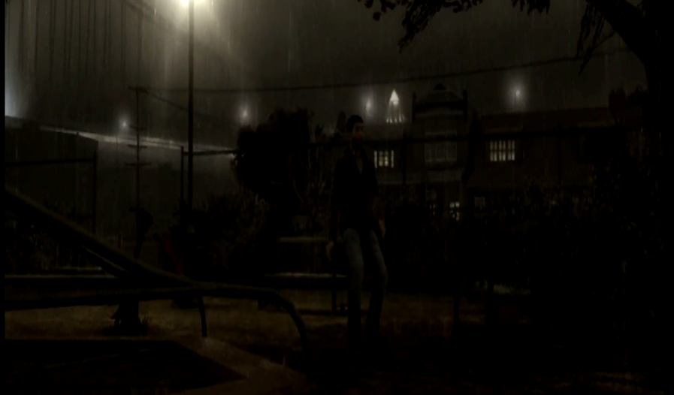
7
Shot description
Long shot
Action We see the main character by himself ‘searching’
Duration – 1 sec
Cut/Edit – fade
Dialogue – voiceover narration 'for a son...'
Music – orchestral violins, dramatic, getting louder and louder, choral voices added
Noise/SFX – heavy rain and thunder

Slide 11
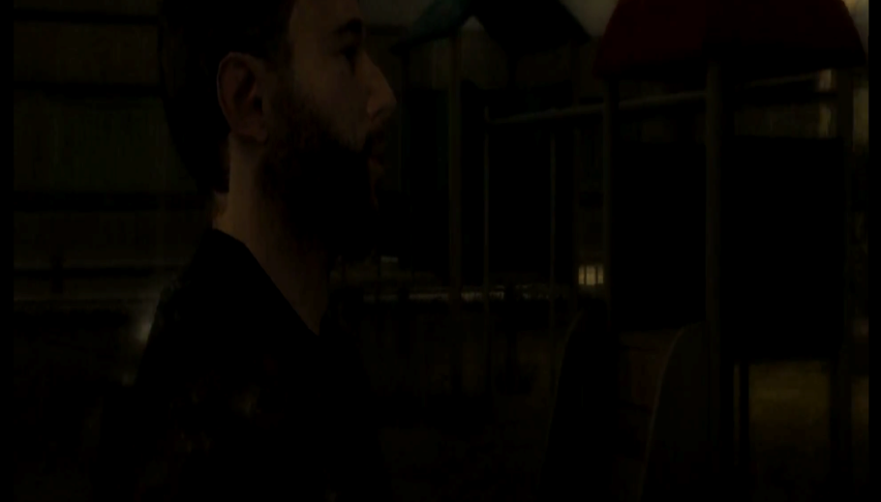
8
Shot description
Mid shot
Action
We see the main character by himself walking
Duration – 2 secs
Cut/Edit – fade
Dialogue – voiceover narration 'and being hunted...'
Music – orchestral violins, dramatic, getting louder and louder, choral voices added
Noise/SFX – heavy rain and thunder

Slide 12
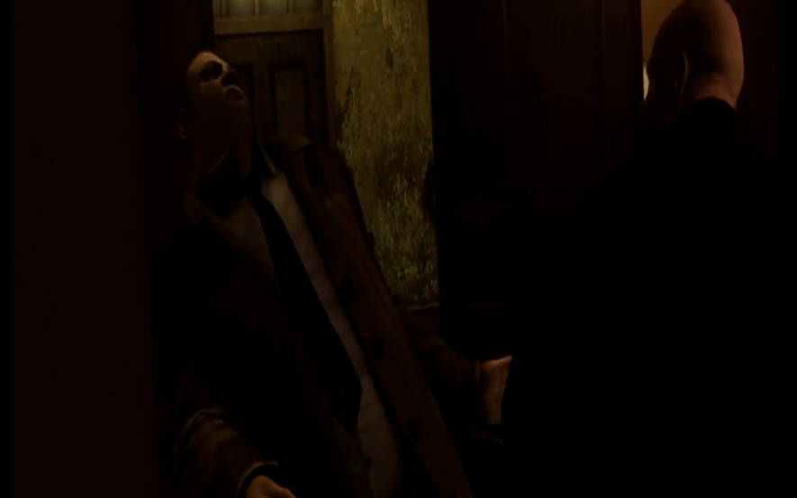
9
Shot description
Two shot
Action
Two characters fighting
Duration – 2 secs
Cut/Edit – fade
Dialogue – voiceover narration 'by a killer...'
Music – orchestral violins, dramatic, getting louder and louder, choral voices added
Noise/SFX – heavy rain and thunder

Slide 13
Creating a Structure for your Video-Game Trailer
Beginning – set-up – what the game is about
Middle – set-up leads to rising action – suggest the exciting bits
End – conclusion – what you have to do to complete the game

